Slide 1
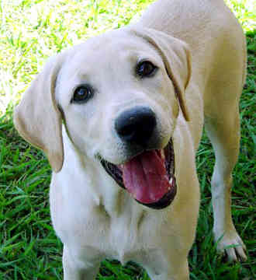
Homeward Bound

Slide 2

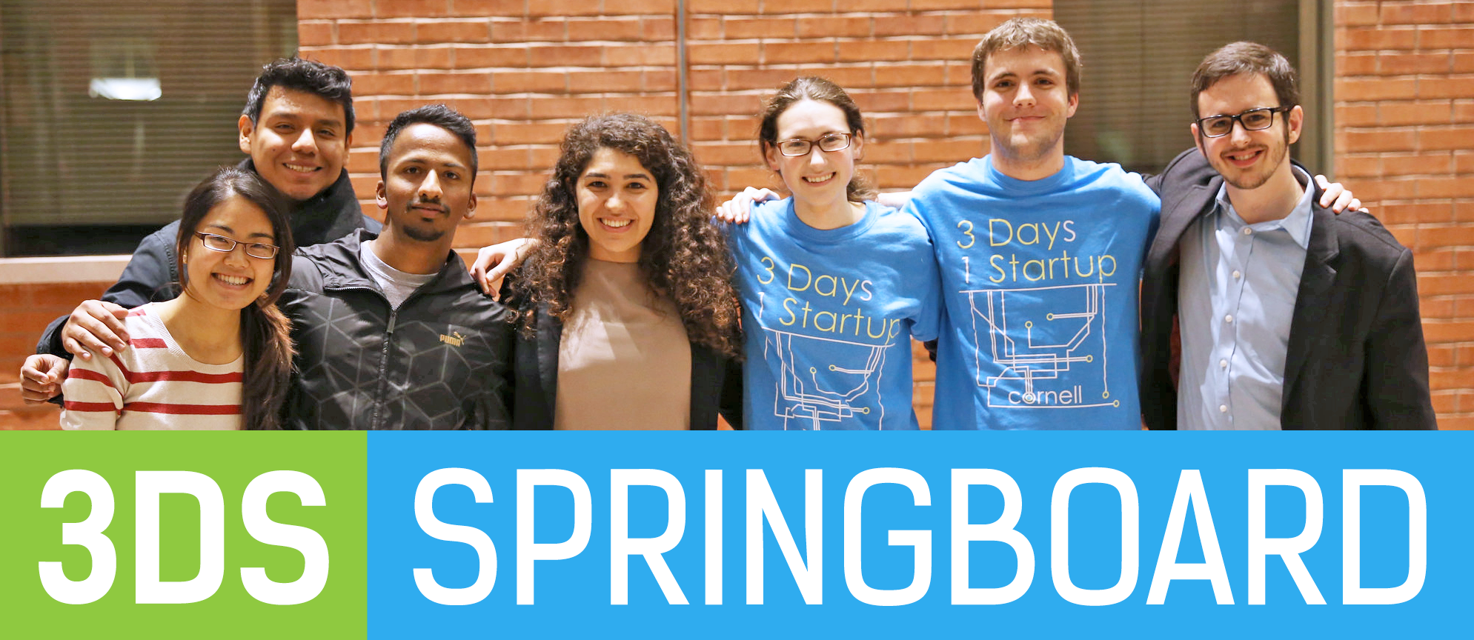
Team

Slide 3
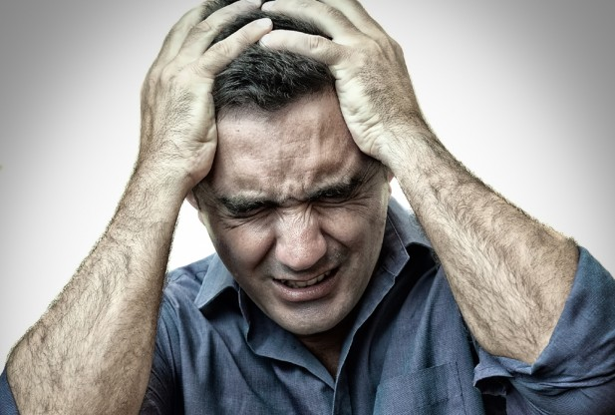
Problem

Slide 4

Solution

Slide 5
Demo Outline
Homepage
Form
Pet profiles
Pet profile page

Slide 6





Tech

Slide 7
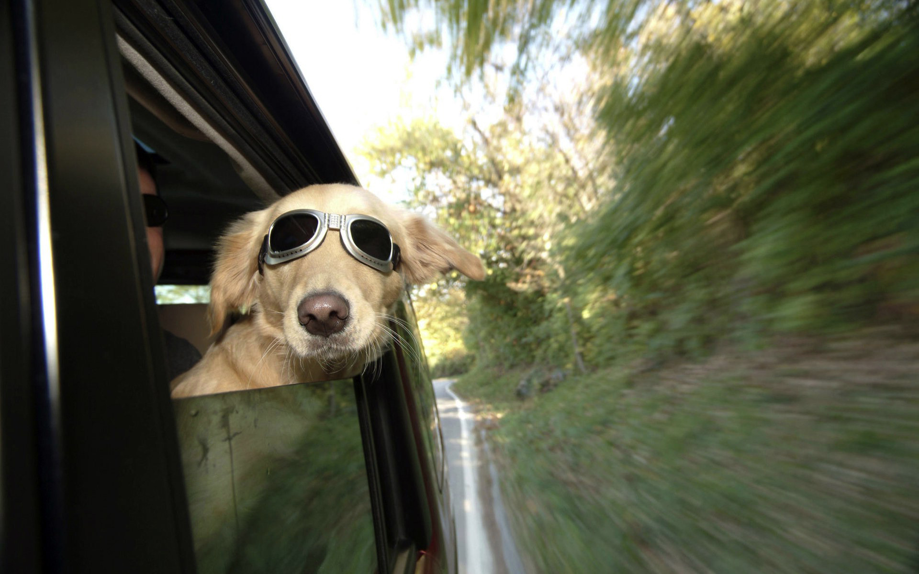
Q&A

